Slide 1


Data for Health Initiative in Asia and the Pacific
Bloomberg Data for Health Initiative
Ashley Frederes Martin Bratschi
Senior Program Officer Deputy Director
Vital Strategies Vital Strategies

Slide 2
Purpose of the Initiative
“Reliable data is absolutely essential to problem solving, and nowhere is it more important than in public health”
- Michael Bloomberg
Save lives and achieve better health by partnering with countries to collect and use accurate public health information
Initiative components
  Non-communicable disease risk factor surveillance
  Strategic use of data for policymaking
  Improving civil registration & vital statistics

Slide 3
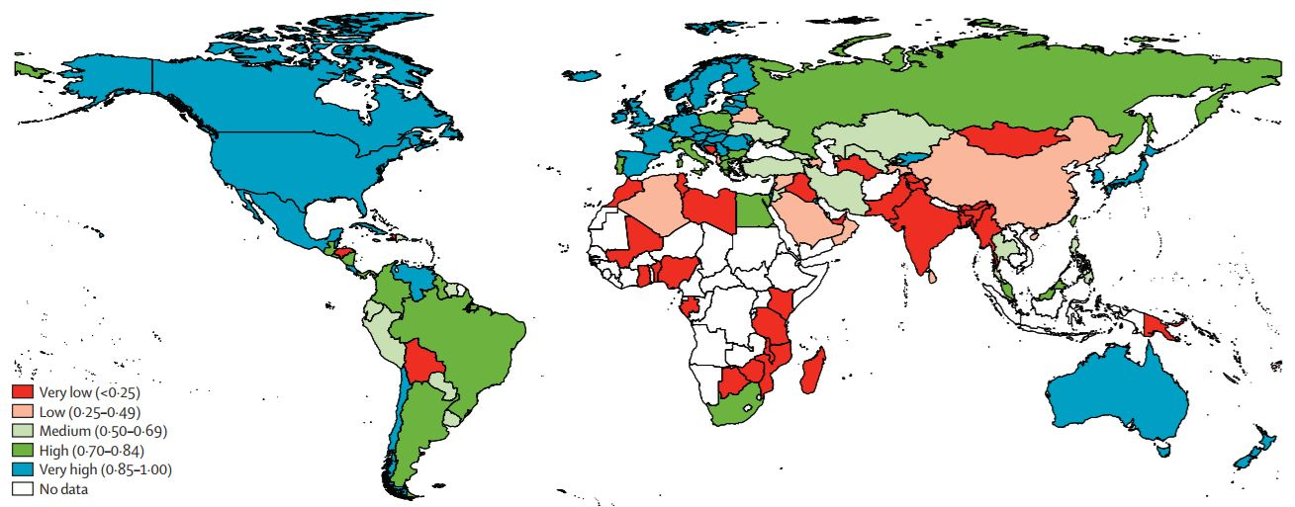
Scale of the Problem
Each Year More Than Half of Deaths Globally Are Not Counted
Even more do not have a
reliable cause of death recorded

Slide 4
Data for Health Initiative
Four year Initiative funded by Bloomberg Philanthropies and Australian Department of Foreign Affairs and Trade
Partnering with 20 low- and middle-income countries and cities worldwide
Multiple international organizations providing technical assistance
  University of Melbourne
  US Centers for Disease Control and Prevention
  Vital Strategies

Slide 5
Data for Health Initiative
TURKEY
CHINA (Shanghai)
MOROCCO
BANGLADESH
MYANMAR
COLOMBIA
INDIA
(Mumbai)
PHILIPPINES
SOLOMON
ISLANDS
ECUADOR
GHANA
SRI LANKA
PAPUA
NEW GUINEA
INDONESIA
RWANDA
TANZANIA
PERU
BRAZIL
ZAMBIA
MALAWI

Slide 6
D4H CRVS Activities
Interventions:
Governance and Coordination
Notification and Registration of Vital Events
Medical Certification of Cause of Death and ICD Coding
Verbal Autopsy

Slide 7
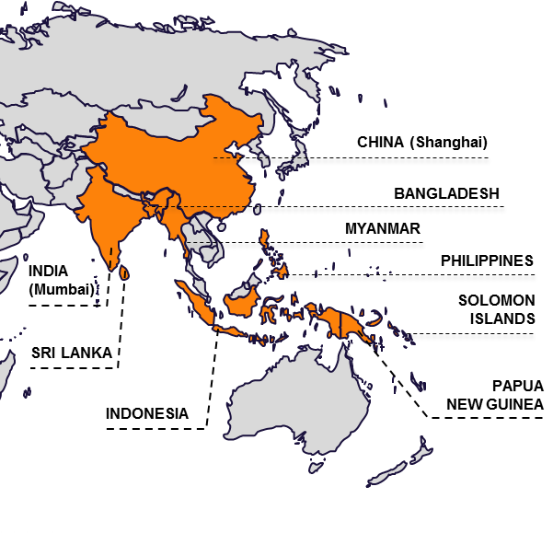
D4H in Asia and the Pacific
Partnered with Ministries of Health, National Statistics Office, and Civil Registration authorities
Targeted technical assistance to give ‘category shift’ to a achieve system changes
Notes:
Medium VSPI 0·50–0·69: includes countries (like Ecuador and Peru) in which the CRVS systems are operational but do not have complete population coverage, and the detail and quality of mortality data are less useful for policy; moreover, data are not consistently made available.
High VSPI 0·70–0·84: includes countries (like Brazil and Colombia) with well functioning systems; all are typically able to register most deaths but their mortality data are less timely and include more ill-defi ned and unspecifi ed causes of death.

Slide 8

PNG: Governance and Coordination Support
Prior to D4H there was a National CRVS Steering Committees in PNG but it was not active.
Support the National CRVS Steering Committees to have regular meetings
Support development of ToR and work plan for the National CRVS Steering Committee

Slide 9

Philippines: Automating ICD Coding
Manual coding system in place with considerable time lag due to large number of deaths to code.
Revision of data transmission to coders
Training of ICD manual coders
Implementation of IRIS (automated coding system)

Slide 10

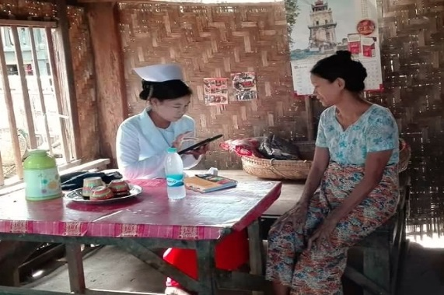
Myanmar: Verbal autopsy
84% of total deaths are community deaths
Introduced VA by Basic Health Staff in 14 Townships
Related next steps:
Scale up to more Townships, raise community awareness and develop SOPs
Courtesy of Country Coordinator Myanmar

Slide 11

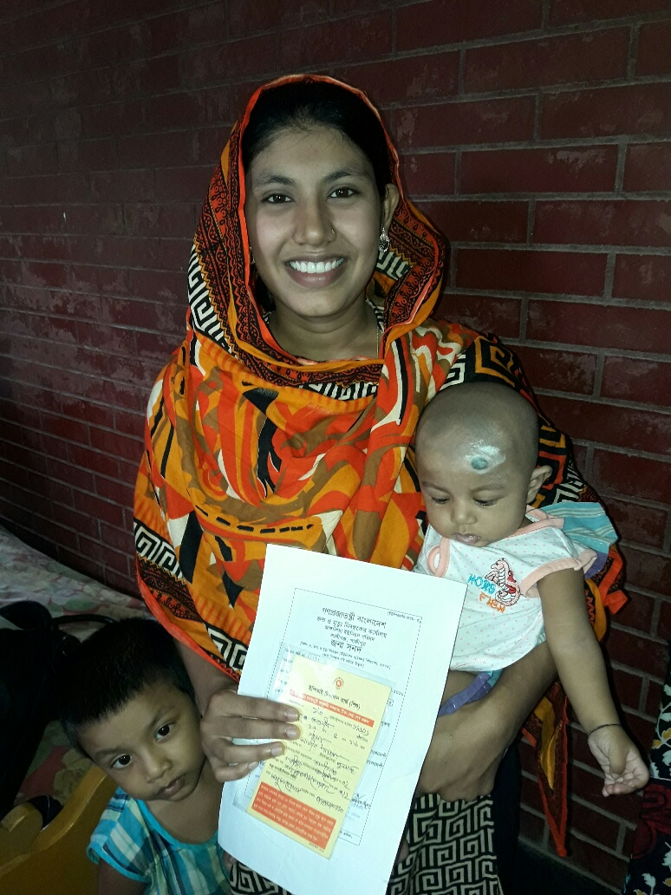
Bangladesh: Health sector assistance to event registration
HA and FWA support families with the registration of births and deaths
Nearly all births and deaths notified and registered in the piloting area
Families are benefitting from a much improved registration process which has the potential to greatly increase vital events registration coverage.
Courtesy of Country Coordinator Bangladesh

Slide 12

Questions?
https://www.bloomberg.org/program/public-health/data-health/
Ashley Frederes
    Afrederes@vitalstrategies.org
Martin Bratschi
    Mbratschi@vitalstrategies.org

